Slide 1
Matrices and Sobel Edge Detection
By David Lara

Slide 2
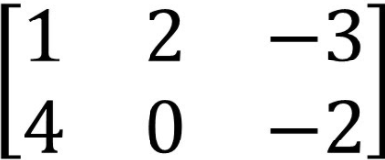
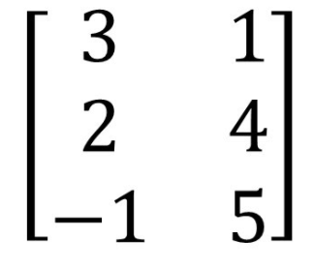
What are Matrices?
A Matrix is a rectangular array of numbers with m rows and n columns. The dimensions of an array can be represented by M x N. This array is treated as a single object.
Ex1: The matrix to the left is a 2x3 matrix, denoted by it’s 2 rows and 3 columns.
Ex2: The second matrix to the left is a 3x2 matrix, denoted by its 3 rows and 2 columns.

Slide 3
So what operations can we perform on matrices?

Slide 4
The Matrix Operations Possible
Addition and Subtraction of Matrices
Scalar Multiplication
Multiplication of matrices (Important for Sobel Edge Detection)

Slide 5
Addition of Matrices
Two matrices of the same dimension can have their entries added together. Two matrices with different dimensions cannot be added together.
Example, a 4x3 matrix can only be added to by other 4x3 matrices, other dimensions would not work
Symbolically represented as A + B
A
B
A + B
10 | 5 | 2
3 | 4 | 4
5 | 6 | 6
4 | 6 | 9
8 | 0 | 1
3 | 4 | 6
14 | 11 | 11
11 | 4 | 5
8 | 10 | 12
+
=

Slide 6
Other Properties of Matrix Addition
Many properties that apply to the addition of real numbers also applies to the addition of matrices.
Let matrix A be an M x N matrix, with matrix B & C being a matrix of the same dimension
Commutative Law:
A + B = A + B (The order of addition does not matter)

Slide 7
Addition Properties Cont.
Associate Law:
A + (B + C) = (A + B) + C (Final sum is the same, regardless of initial grouping)
Identity Matrix:
A + O = O + A = A (Adding the zero matrix to a matrix does not change the value of the matrix)
Additive Inverse:
A + (-A) = 0 ( -A is obtained by changing multiplying each entry in A by -1)
A + B = 0 = B + A ( B is the additive inverse of A)

Slide 8
Subtraction of Matrices
If matrix A & B are of the same dimension M x N, then we can define a subtraction of these elements as A - B = A + (-B). Where each individual entry is subtracted from its corresponding element in the second matrix
A
B
A - B
10 | 5 | 2
3 | 4 | 4
5 | 6 | 6
4 | 6 | 9
8 | 0 | 1
3 | 4 | 6
6 | -1 | -7
-5 | 4 | 3
3 | 12 | 0
=
-

Slide 9
Scalar Multiplication of Matrices
Lets say Matrix A is defined as [a_{ij}]_{M x N} and K is some number, then the operation of multiplying both the scalar and the matrix would result in k x A where each element in the matrix is multiplied or “scaled” by the number K
Ex:
K
A
kA
10 | 5 | 2
3 | 4 | 4
5 | 6 | 6
50 | 25 | 10
15 | 20 | 20
25 | 30 | 30
5
x
=

Slide 10
Multiplication of Matrices
Let us define two matrices A which is of size M x N and B which is of size N x P. The matrix product of AB is only well defined when the number of columns “N” in A is the same as the number of rows “N” in B.
If A = [a_{ij}]_{M x N} and B = [b_{ij}]_{N x P} then the product of AB = C = [c_{ij}]_{M x P} where C will be a matrix of dimensions M x P, (AB)_{ij} = C_{ij} = 𝛴 a_{ij}b_{rj} (from r =1 to N)

Slide 11
Multiplication of Matrices
In Layman's terms, you multiply the entries in the ith row of the first Matrix are multiplied by entries of the jth column in the second matrix, and then summed up.
Example:
10 | 5
3 | 2
4 | 10
8 | 19
(10 x 4) + (5 x 8) | (10 x 10) + (5 x 19)
(3 x 4) + (2 x 8) | (3 x 10) + (2 x 19)
x
=
80 | 195
28 | 68
=

Slide 12
Properties about Matrix Multiplication
Matrix Multiplication is not Commutative:
AB does not equal BA
However, it is associative:
(AB)C = A(BC) Granted they are all valid operations
It is distributive over matrix addition
A(B+C) = AB + AC

Slide 13
So how are matrices useful?
You may be asking, why I’m even talking about matrices.
However, they are extremely important in Sobel Edge Detection, a method where information about an image is used to determine where an edge begins and where it ends

Slide 14
So what exactly is Sobel Edge Detection?
Sobel Edge Detection is an algorithm that works by taking a matrix that is smaller than an input image, known as the kernel, over every pixel in the input image.
Each time the matrix is run over the image, we measure the change in the gradient within the kernel
A greater change in pixel intensity signifies a more significant edge in an image
Works best on a gray-scale image!

Slide 15
Find the Convolution Matrix of the Image
Before we even try to detect any edges of the image, we first need to find the Convolution of the image, which is the process of multiplying and adding corresponding indexes of the kernel and the image matrix

Slide 16
Example: Finding the convolution of an Image
Let's say we had an image that took on these values in a matrix and that we wanted to find the convolution of the image. In order to do this we would multiply values of the image matrix by a 3x3 matrix filled with 1s.
Lets select this portion of the matrix to convolute
17 | 14 | 13 | 9 | 5
3 | 65 | 32 | 43 | 10
3 | 45 | 34 | 85 | 43
10 | 54 | 10 | 76 | 90
39 | 74 | 65 | 86 | 52

Slide 17
17 | 14 | 13 | 9 | 5
3 | 65 | 32 | 43 | 10
3 | 45 | 34 | 85 | 43
10 | 54 | 10 | 76 | 90
39 | 74 | 65 | 86 | 52
1 | 1 | 1
1 | 1 | 1
1 | 1 | 1
17 | 14 | 13
3 | 65 | 32
3 | 45 | 34
=

Slide 18
Next...
We then sum up the values in the kernel, and divide them by the sum of the values in the kernel, which in this case is 9
17 | 14 | 13
3 | 65 | 32
3 | 45 | 34
Sum of kernel is: 226
226/9 = 25.1111 which rounded down is 25.

Slide 19
Next...
We take our value we calculated and place it in a new matrix with the same dimensions of our image matrix and place the value where we took the value from the center of our moving kernel. We then keep doing this for each value in the original image matrix.
For values at the edge you would take a smaller average of the values to account for the empty space that would be in the moving 3x3 kernel.
17 | 14 | 13 | 9 | 5
3 | 65 | 32 | 43 | 10
3 | 45 | 34 | 85 | 43
10 | 54 | 10 | 76 | 90
39 | 74 | 65 | 86 | 52
 | 25

Slide 20
But...
While taking an average of the values within the image matrix is a valid way of detecting edges, there is a better way that involves a more precise method of finding the shift of intensity in colors in an image.
This is where the Sobel Operator comes into play!

Slide 21
What is the sobel operator?
The Sobel Operator is an approximation of the derivative of an image. Another word for this would be a discrete derivative.
It is necessary to take discrete derivatives in both the x and y direction of the image.

Slide 22
Discrete Derivatives in the X and Y direction
In order to find the gradient of our image in the x or y direction we would use the respective 3x3 kernels to do so.
-1 | 0 | 1
-2 | 0 | 2
-1 | 0 | 1
1 | 2 | 1
0 | 0 | 0
-1 | -2 | -1
G_{x}
G_{y}
These specific numbers are chosen in order to find the gradient of change in the image to detect and edge. The zeroes in the middle are useful for detecting vertical or horizontal lines in the x or y direction respectively

Slide 23
Cont.
Just like before, we will iterate over the entire image using our 3 x 3 kernel.

Slide 24
Cont.
50 | 50 | 100 | 100
50 | 50 | 100 | 100
50 | 50 | 100 | 100
50 | 50 | 100 | 100
50 | 50 | 100 | 100
What we have to our left is an edge
However, computer doesn’t know that
We can apply the sobel operator in the X direction

Slide 25
Applying Sobel Operator in X Direction
50 | 50 | 100 | 100
50 | 50 | 100 | 100
50 | 50 | 100 | 100
50 | 50 | 100 | 100
50 | 50 | 100 | 100
-1 | 0 | 1
-2 | 0 | 2
-1 | 0 | 1
=
Cont. on next page...

Slide 26
Applying Sobel Operator in X Direction cont.
(50 x -1) + (50 x 0) + ( 100 x 1) +(50 x -2) + (50 x 0) + ( 100 x 2) + (50 x -1) + (50 x 0) + ( 100 x 1)
We sum this up and we get 200 for our gradient in the X direction, meaning that there is a great change in color.
We keep running the 3x3 kernel on the image, using the same principles as before for edges.

Slide 27
Understanding the values we get and what they mean
Let's say we applied the sobel operator on a part of an image that is all the same color, therefore it would have the same value throughout.
We would get a value of zero meaning that there is no change in value.
I’ll get to what we do to normalize negative values..
Next we apply the sobel operator in the Y direction

Slide 28
Applying Sobel Operator in Y Direction
50 | 50 | 50 | 50
50 | 50 | 50 | 50
100 | 100 | 100 | 100
100 | 100 | 100 | 100
100 | 100 | 100 | 100
1 | 2 | 1
0 | 0 | 0
-1 | -2 | -1
=
Cont. on next page...

Slide 29
Applying Sobel Operator in Y Direction cont.
(50 x 1) + (50 x 2) + ( 50 x 1) +(50 x 0) + (50 x 0) + (50 x 0) + (100 x -1) + (100 x -2) + ( 100 x -1)
We sum this up and we get -200 for our gradient in the Y direction,
We keep running the 3x3 kernel on the image, using the same principles as before for edges.

Slide 30
Next Step and Final Step
The purpose of doing all of this was to obtain a gray-scale image that we can perform edge detection on, since it is much easier to apply sobel-edge detection to gray-scale images as opposed to colored images.
We will then take the magnitude of these two gradient values and find the magnitude of these values
Similar to finding the long side of a right triangle using the pythagorean theorem

Slide 31
Equation to find the Magnitude of the Gradient in the X and Y direction
G = √(Gₓ)²+(Gᵧ)²
Taking the magnitude is necessary in order to get rid of any negative symbols.
As stated before, a value of 0 will indicate a constant color
The G will tell us how large our gradient is at a specific location

Slide 32
Calculating the angle of an edge
Now that we have the gradient of the edge, we can use it to calculate the angle of the edge.
Given by using:
Arctan ( G_{y}/G_{x})
This value will tell you the orientation of your edge in radians or degrees

Slide 33
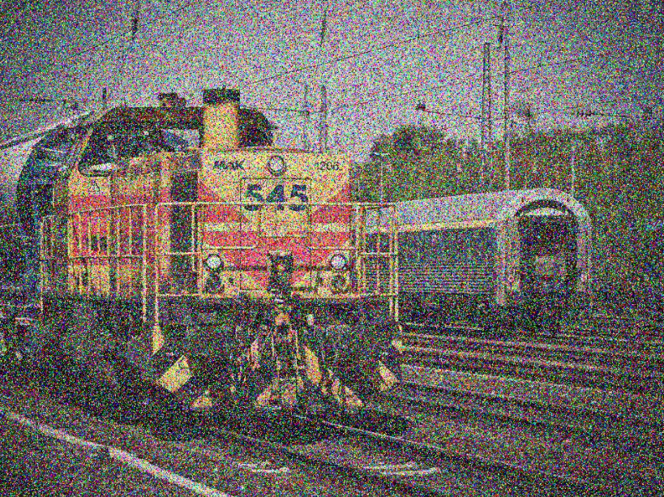
Closing and Important Information on the Sobel Operator
As stated before, this will only work on grayscale images
The image also needs to be free of noise in order for the sobel operator to not pick up the noise as an edge. Example of a noisy image:

Slide 34
Closing and Important Information on the Sobel Operator
If we do have a noisy image, then a gaussian filter must be applied before any processing is done on the image.
It’s a filter designed to combat noise in images.

Slide 35
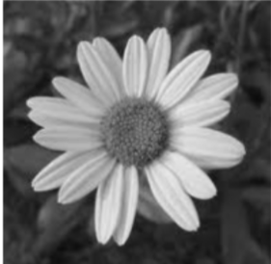
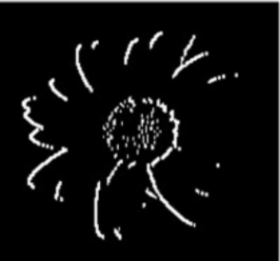
And our final result is..

